Slide 1
UNITAR HACKATHON PROJECT
Project theme ( social and community management)
Topic :Assessing the unemployment level of youths in Africa

Slide 2
    Project goals
1. To assess the unemployment levels of youths in Africa.
2. To determine inhibiting factors affecting
employment of youths living in Africa

Slide 3
Unemployment Levels Of Youths In Africa
Africa is the second largest continent with a land mass that covers one-fifth of the earth's total land surface. Africa also has a population of over 1 billion people according to the latest United Nations estimates, of which around 40% of the population is aged 15 years and younger, 60% of the entire continent is aged below 25, and it is expected to continue to grow.
About 70% of Sub-Saharan Africa is under the age of 30. Thus, Africa is a continent that has the youngest population in the world.

Slide 4
Unemployment Levels Of Youths in Africa
Africa having the youngest population in the world, surely places the continent at a great advantage. Africa is a diverse and culturally rich continent, with abundance of natural resources and exceptional talents, imagine what happens if Africa employs its youthful energy to exploit its vast wealth? The African youths is an opportunity for the continent's growth, but sadly, these youths potentials have been underutilized, most do not even have access to decent jobs, and this is one of the significant challenges, Africa faces.

Slide 5
Unemployment Levels Of Youths In Africa
Currently, the unemployment level of youths in Africa is said to be more; Africa has about an averaging of 20% unemployment across the continent.
In some countries the unemployment rate is as high as 60 - 80%, with Sub-Saharan Africa at over 30%.
Nigeria has about 11.9million unemployed youths, Egypt, Kenya, Ethiopia, Ghana, Tanzania, Algeria has 3.1, 1.4, 2.5, 1.5, 1.5, 1.2 million respectively.
A recent ILO(International Labour Organisation) report states; "More than 72 million Youth in Africa are not in education, employment, or training(NEET).
Djibouti had the highest youth unemployment rate in 2022 with about 80%. South Africa, libya and Estwatini is not left behind, they recorded 52, 51.5 and 49.8% respectively. This 2024, ILO predicts that about 11.2% of the African youth between 15 - 24 years will be unemployed, and the figure has remained stable since 2021. This, itself is quite alarming as research says that by 2030 the number of youths in Africa will have increased to 42%.

Slide 6
Factors Inhibiting The Employment of Youths In Africa
The African youth primary obstacle to employment is education and scarcity of jobs.
The schooling rate in Africa has increased in the last decade, but what is the quality of education given, is it enough to attain the optimal development of Africa and to provide the youth with financial security?
Inaccessibility of quality education hinders the ability of African youths to access decent jobs.

Slide 7
Factors Inhibiting The Employment Of Youths In Africa
Other factors affecting the employment of youths in Africa include;
Gender Inequality
North Africa has a labour force participation rate for women at 33.4%. The discrimination of Younged girls in the labor force has contributed to unemployment amongst the gender.
Scarcity of decent Jobs
Availability of low-paying jobs
Armed conflicts in regions in Africa. Youths living in fragile conflict zones experience several labor market barriers, and ability to earn income.
Early family responsibilities
Lack of employable skills amongst African youths and several other factors.

Slide 8
Methodology
In this project of assessing unemployment levels of youth in Africa, quantitative research method was used. We mostly focused on data and survey results that were conducted in different African countries by different organizations.

Slide 9
Africa is a young continent, with almost 60% of its population under the age of 25.
More than 1 in 4 young people in Africa –around 72 million- are not in employment, education or training(NEET). Two thirds of them are young women. (ILO)
Unemployment levels varied significantly across African countries. South Africa was estimated to register the highest rate in 2024 at around 30%.(statistica.com)
Young women in sub Saharan Africa face more obstacles to participation in the labor market and recorded a NEET rate of nearly 33% in 2022. (ILO)

Slide 10
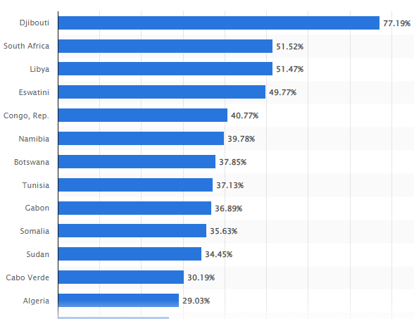
Youth unemployment rate in Africa as of 2022, by country

Slide 11
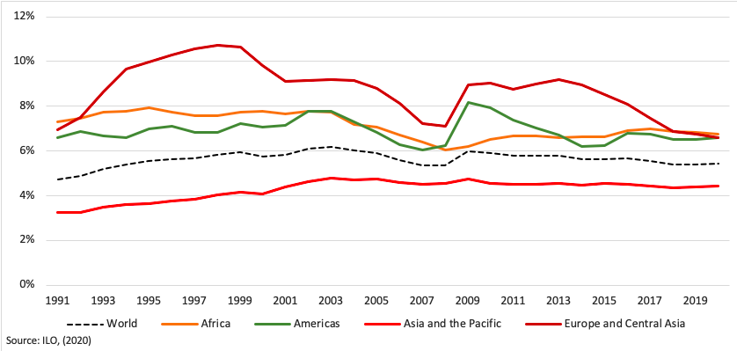
Global And Regional Unemployment Rate
Africa has the lowest youth unemployment rates (11%) as compared to the other continents.

Slide 12
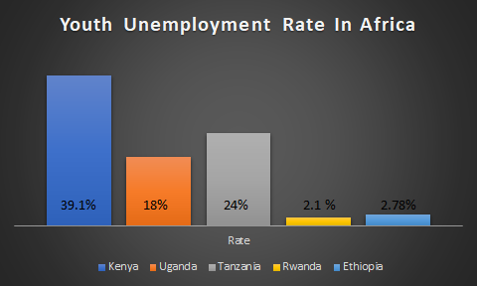
Meanwhile, some countries are thriving. According to the report, the reduced unemployment rate in some African countries is attributed to the fact that most young people have delved into agriculture hence bridging the gap between job opportunities in the formal and informal job sectors.

Slide 13
CONCLUSION
The Unemployment of African youths is also directly responsible for the high poverty levels in Africa. Therefore it is necessary that Africa identifies the key causes of unemployment in these regions and seek out effective measures to decrease the unemployment rate, and over time it becomes a history tale.
Perhaps, the continent's growth in this sector(employment), could be achieved if this new generations(youth) is fully empowered to utilize their best and untapped potentials. Building employable skills amongst the youths, increasing the quality of education, implementing youth employment programs/ platforms tailored to attain economic growth, are good measures that should be implemented.

Slide 14
REFERENCES
https://www.ilo.org/wcmsp5/groups/public/@dgreports/@dcomm/@publ/documents/publication/wcms_513739.pdf
https://www.statista.com/statistics/812300/youth-unemployment-rate-in-nigeria/
https://www.statista.com/statistics/1288721/number-of-people-unemployed-in-nigeria/
https://www.statista.com/statistics/1119403/youth-unemployment-rate-in-nigeria-by-quarter/
https://www.statista.com/statistics/1288721/number-of-people-unemployed-in-nigeria/
https://www.statista.com/statistics/1288552/unemployed-population-in-nigeria-by-age-group/
www.leadersofafrica.org/analysis/youth-unemployment-dilemma-in-africa-recent-data/
www.statistica.com/
ilostat.ilo.org/data/africa/
https://www.summitrecruitment-search.com/current-youth-unemployment-rate-in-africa-in-2019/

Slide 15
https://www.ilo.org/wcmsp5/groups/public/@dgreports/@dcomm/@publ/documents/publication/wcms_513739.pdf
https://www.britannica.com
https://www.worldometers.info
https://www.ilostat.ilo.org
https://www.un.org
https://www.wikipedia.org
https://www.alliance2015.org
https://www.weforum.org

